Slide 1
Analysis of Australia’s Population in relation to the world population.
James Le Kathleen Lopokoiyit
Radhika Alapati Dante Company

Slide 2

introduction
The Outlook for the Australian Economy is constantly changing and being driven by different factors.
The economic growth is forecast to be slower and inflation higher.
We have looked at how the changes in Population has impacted the Economic Growth over a 10 Year Period.
For the world, over the period of 1990-2015, the correlation between population growth and real GDP per capita, based on the World Bank report 2017, data, was -0.1849 suggesting that these two variables were uncorrelated during that period.

Slide 3

Objectives of the Study
To explore key aspects of the changes in Australian GDP in the past 10 years.
To compare changes in the Australian growth to that of the World Population.
Does the population growth impact the Economic growth of Australia.
To find out if the Birth and Death Rate have had an impact on the natural increase in population
To describe how migration has impacted changes affected the population growth in Australia.
To show projected changes in the Australian Population growth with changes in the migrated populations.
To compare the World GDP per capita to Australia’s GDP

Slide 4
Hypothesis
H0: Changes in the Australian Economy have not affected the Population.
H1: Changes in the Australian Economy have had an impact on the Population.
H0: There is no Correlation between GDP per Capita and the Population Growth.
H1: There is a Positive Correlation between GDP per Capita and the Population Growth
H0: Immigration has not had a Significant Impact on Australia’s and the World’s Economy
H1: Immigration has had a Significant Impact on Australia’s and the World’s Economy

Slide 5
Questions
Is there a Relationship between the GDP per Capita and the Population Growth?
Has Migration played a Significant Impact on Australia’s and the World’s Economy?
How changes in the population have impacted the GDP growth in a 10 year period.

Slide 6
WBGAPI
Pythonic access to the World Bank’s Data API.
Australian Economic data are pooled for the period of 2010-2020 from the World Bank API. Key economic indicators are compared against the population changes within the same time period.

Slide 7
Data Exploration & clean-up
ABS(Australian Bureau of Statistics) data has been taken for Australia Population, Migration and GP per Capita.
World Bank data has been taken for World Population, GDP
The input data from ABS has some special characters which has been removed to eliminate data processing errors
World Bank data NULL values has been replaced with Zeros to improve data quality and processing

Slide 8
Data analysis
Australia Population vs GDP per Capita Impacted by Immigration
Australia Natural Growth
Australia Population Growth for last 10 Years including Natural and Immigration Growth
Australia GDP Per Capita Growth
Australia vs World GDP Per Capita Growth
Australia Immigration Growth
World GDP Per Capita Growth
Australia Position in Top 10 Immigration Countries in the world
Australia vs World Population Growth
Australia Position in Top 10 Immigration Countries in the world(GDP)

Slide 9
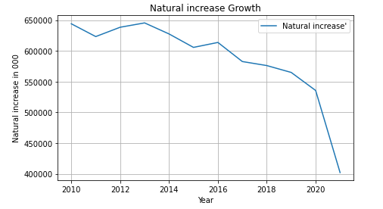
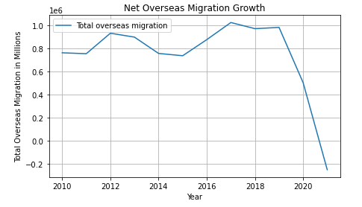
Australia Population Natural Increase and Immigration Growth Rate from 2010 to 2020

Slide 10
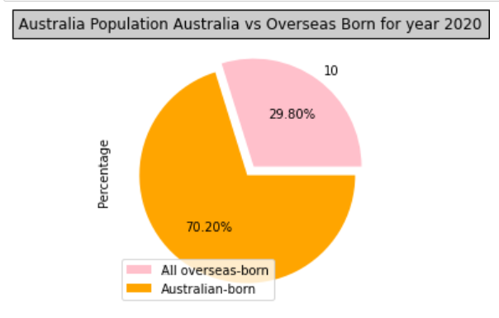
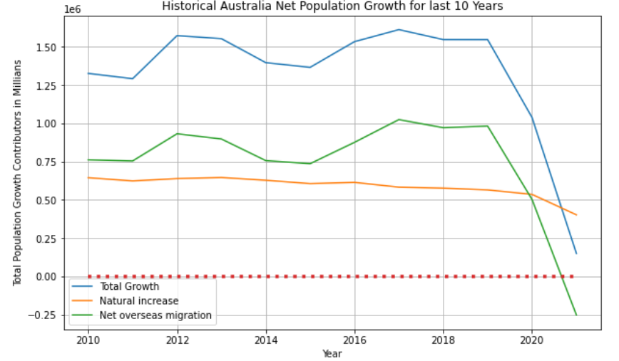
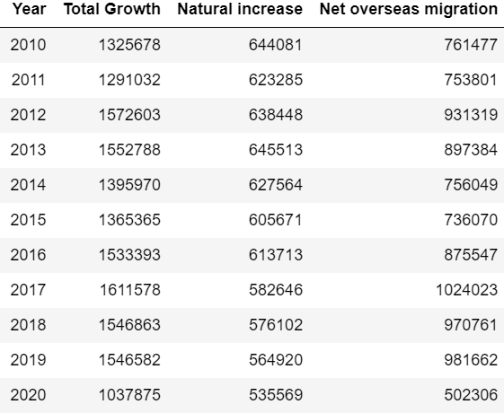
Australia Net Population Growth Rate from 2010-2020 -- Migration Population Contribution in Australia population as of 2020

Slide 11
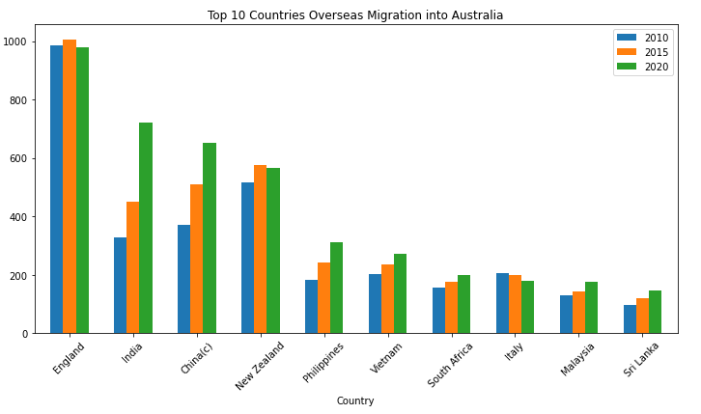
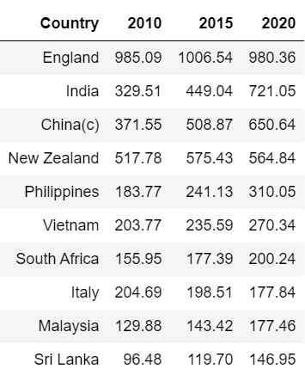
Top 10 Countries Overseas Migration into Australia. 2010, 2015, 2020

Slide 12
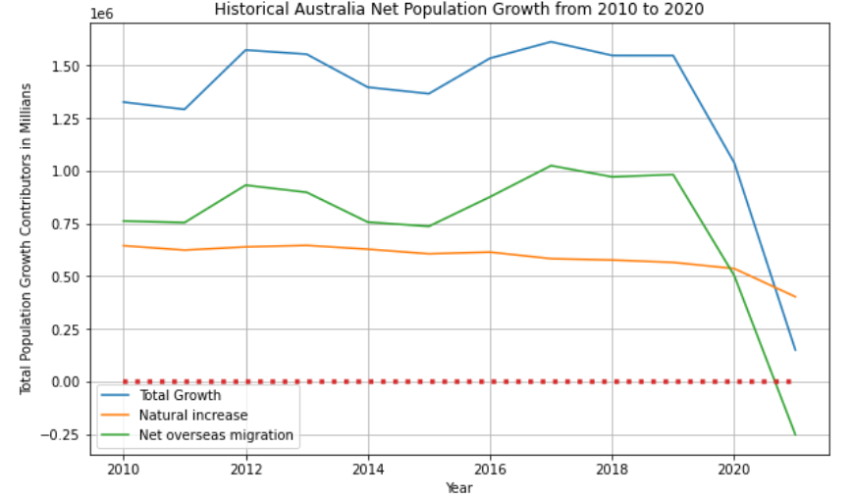
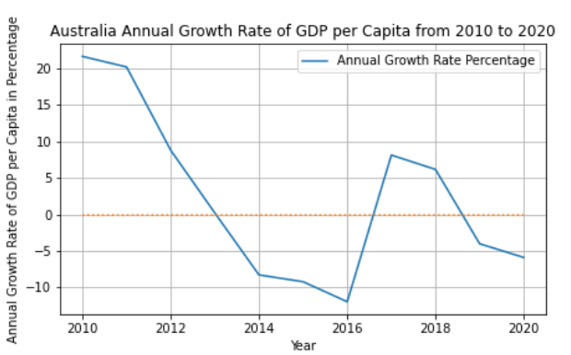
Final Analysis -- Australia Population vs GDP Per Capita Growth from 2010 to 2020

Slide 13
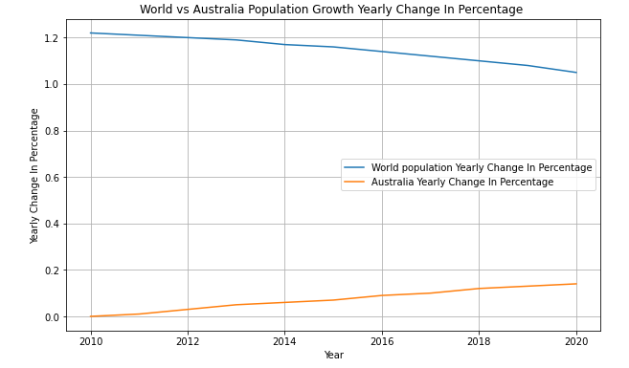
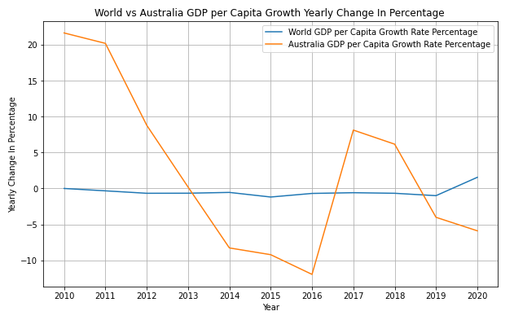
World Population vs Australia Population Growth Rate from 2010 to 2020

Slide 14
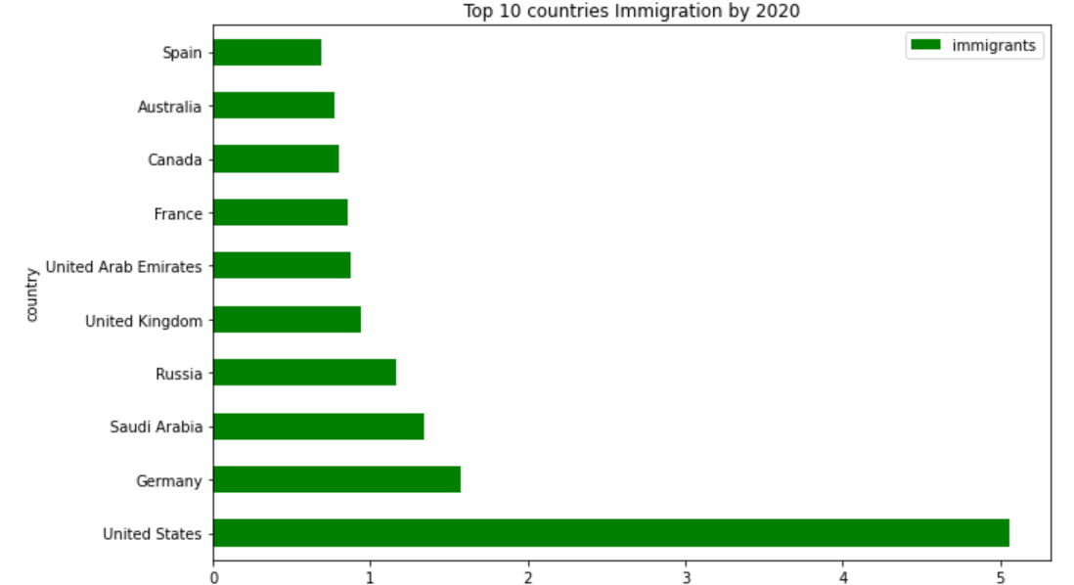
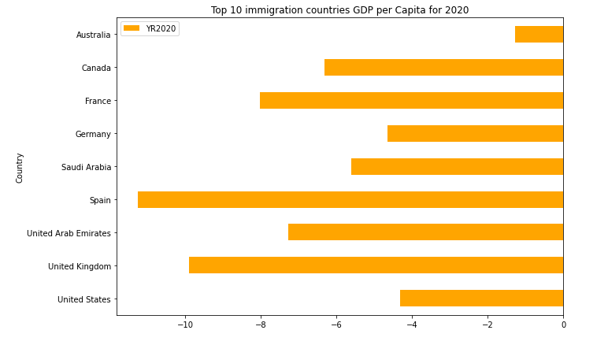
Australia Place in Top 10 Immigration countries based on Immigration Growth and GDP Per capita Growth for 2020
1st Place
9th Position

Slide 15
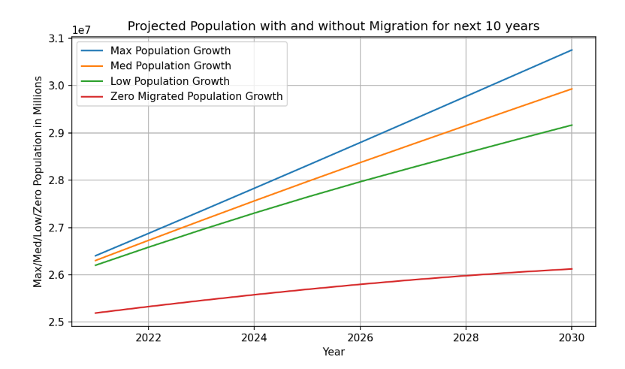
Australia Projected Population with and without Migration for 2020-2030

Slide 16
FINDINGS
Australia's population growth rate has been trending higher during the period of study(2010-2020) to 0.14%
While the Australian population growth rate has experienced a steady increase during the period of study, The world population growth has been decreasing from 1.22% to 1.05%
Historical data for the period of study 2010-2020 shows that migration accounts for large part of the Australian population growth as compared to the natural increase. The projected migration rates shows a positive correlation between migration and population growth. Australia ranks at number 9 among the countries with highest migration rates. Australia receives the highest number of migrants from England.
Our Analysis shows that GDP per Capita in Australia changes proportionately with population growth. During the period when population growth is low, GDP is also low. For the whole world, there is barely any changes in GDP with changes in population growth.
There has been a decline in the population growth during the period of 2019-2021. This can be attributed a decline in overseas migration into Australia during the period of 2019-2021.

Slide 17
Conclusions
Our analysis supports the idea that population growth is an important factor in the overall economic growth and may contribute to increased growth in per capita output.
During the period of 2019-2021, there has been a decline in population growth This can be attributed to a decline in migration due to covid 19. This is however not conclusive as this analysis does not look at that data or address this question.
Drawing on the economic analysis on migration, it appears that lower population growth and limited migration may contribute to increased national and global economic inequality.
Australia’s GDP per capita is the second lowest when compared to the top 5 highest populated countries in the world. Indonesia more populated than Australia and has a lower GDP per Capita. This implies that Low population growth in high-income countries is likely to create social and economic problems while high population growth in low -income countries may slow their development.

Slide 18
Resources
https://www.abs.gov.au/
https://pypi.org/project/wbgapi/

Slide 19

Questions

Slide 20
Thank you

